Slide 1
Focusing on Subtleties: Class-Specific Attention-Based Deep Learning for Precise Diagnosis of Lung and Colon Cancers.
Focusing on Subtleties: Class-Specific Attention-Based Deep Learning for Precise Diagnosis of Lung and Colon Cancers.
Presented By
A K Z Rasel Rahman
Khulna University, Khulna, Bangladesh
Email:rasel1716@cseku.ac.bd

Slide 2
Introduction
Cancer, a leading global health threat, led to 9.6 million deaths in 2018[1].
Lung and colorectal cancers significantly impact global mortality rates.
Limited diagnostic resources, especially in Bangladesh, highlight the need for innovative solutions [2].
Advances in AI, ML, and DL offer transformative potential in early detection and personalized treatment.

Slide 3
Problem Statement
Complex cancer diagnostics demand high precision and speed.
Conventional diagnostic methods are costly and challenging, especially in resource-limited settings.
There is a critical need for accessible and accurate diagnostic tools that improve early cancer detection and patient outcomes.

Slide 4
Related work
Hasan et al. [3]
Developed a lightweight multi-scale CNN with 1.1M parameters.
Achieved 99.20% accuracy in multi-class cancer detection.
Explain ability tools were applied to highlight critical data areas.
Provath et al. [4]
Proposed CNN with global context attention guidance.
Accuracy:96.5% (patient).
Used GAN for data augmentation and Grad-CAM for interpretability.
Challenges: Authenticity concerns with GAN data, lower precision and sensitivity impacting reliability.

Slide 5
Related work
Al Ghamdi et al. [5]
Introduced BERTL-HIALCCD using Al-Biruni Earth Radius Optimization.
Improved ShuffleNet with Coati Optimizati
Accuracy: 99.22% with robust class-specific analysis.
Focus on optimization, with potential for higher accuracy and enhanced visual explanations.
Mangal et al. [6]
Designed a CNN-based diagnostic system for adenocarcinoma and squamous cell
carcinoma classification in lung pathology.
Focused on the LC25000 dataset with notable accuracy, foundational for lung cancer detection.
Bijaya Kumar et al.[7]
Created a CNN model targeting benign tissue, adenocarcinoma, and squamous cell carcinoma using the LC25000 dataset.
Achieved accuracies of 96.11% and 97.2% in lung cancer classification.

Slide 6
Related work
Masud et al [8]
Utilized 2D Discrete Fourier and Wavelet Transforms for tissue classification.
Accuracy: 96.33% with five tissue types but limited explain ability and class-specific details.
Dabass M et al. [9]
Developed CNN architecture with Transitional Modules and Multi-level Attention for colon cancer diagnosis.
Accurate for cancer grading and tissue structure analysis, though not specifically interpretable.
Limitations in Prior Studies
Many methods lack explain ability and did not use whole dataset.
Our Approach: Tackles these issues using class-specific attention (CSA)
to improve classification accuracy and model interpretability.

Slide 7
Research Questions
How can deep learning and attention mechanisms be leveraged to differentiate benign
from cancerous tissues in lung and colon histopathology images?
What model modifications would enhance diagnostic accuracy, interpretability,
and trustworthiness?

Slide 8
Objectives
Develop a Highly Accurate Model
Create an attention-based deep learning model for classifying lung and colon cancer tissues with a focus on high accuracy.
Enhance Interpretability
Integrate LIME and Grad-CAM visualizations to make the model's decisions transparent for clinical applications.
Provide a Resource-Efficient Solution
Address diagnostic challenges in low-resource settings, making AI diagnostics more accessible, particularly in regions like Bangladesh.

Slide 9
Outcomes and Impacts
Achieved 99.64% Diagnostic Accuracy
Reliable model performance in identifying benign vs. cancerous tissues for lung and colon cancers.
Strengthened Clinical Trust Through Visualization
LIME and Grad-CAM interpretations support transparency, increasing confidence in AI-driven cancer diagnostics.
Real-World Application Potential
Cost-effective solution suited for low-resource settings, contributing to early
cancer detection efforts in areas with limited diagnostic infrastructure.

Slide 10
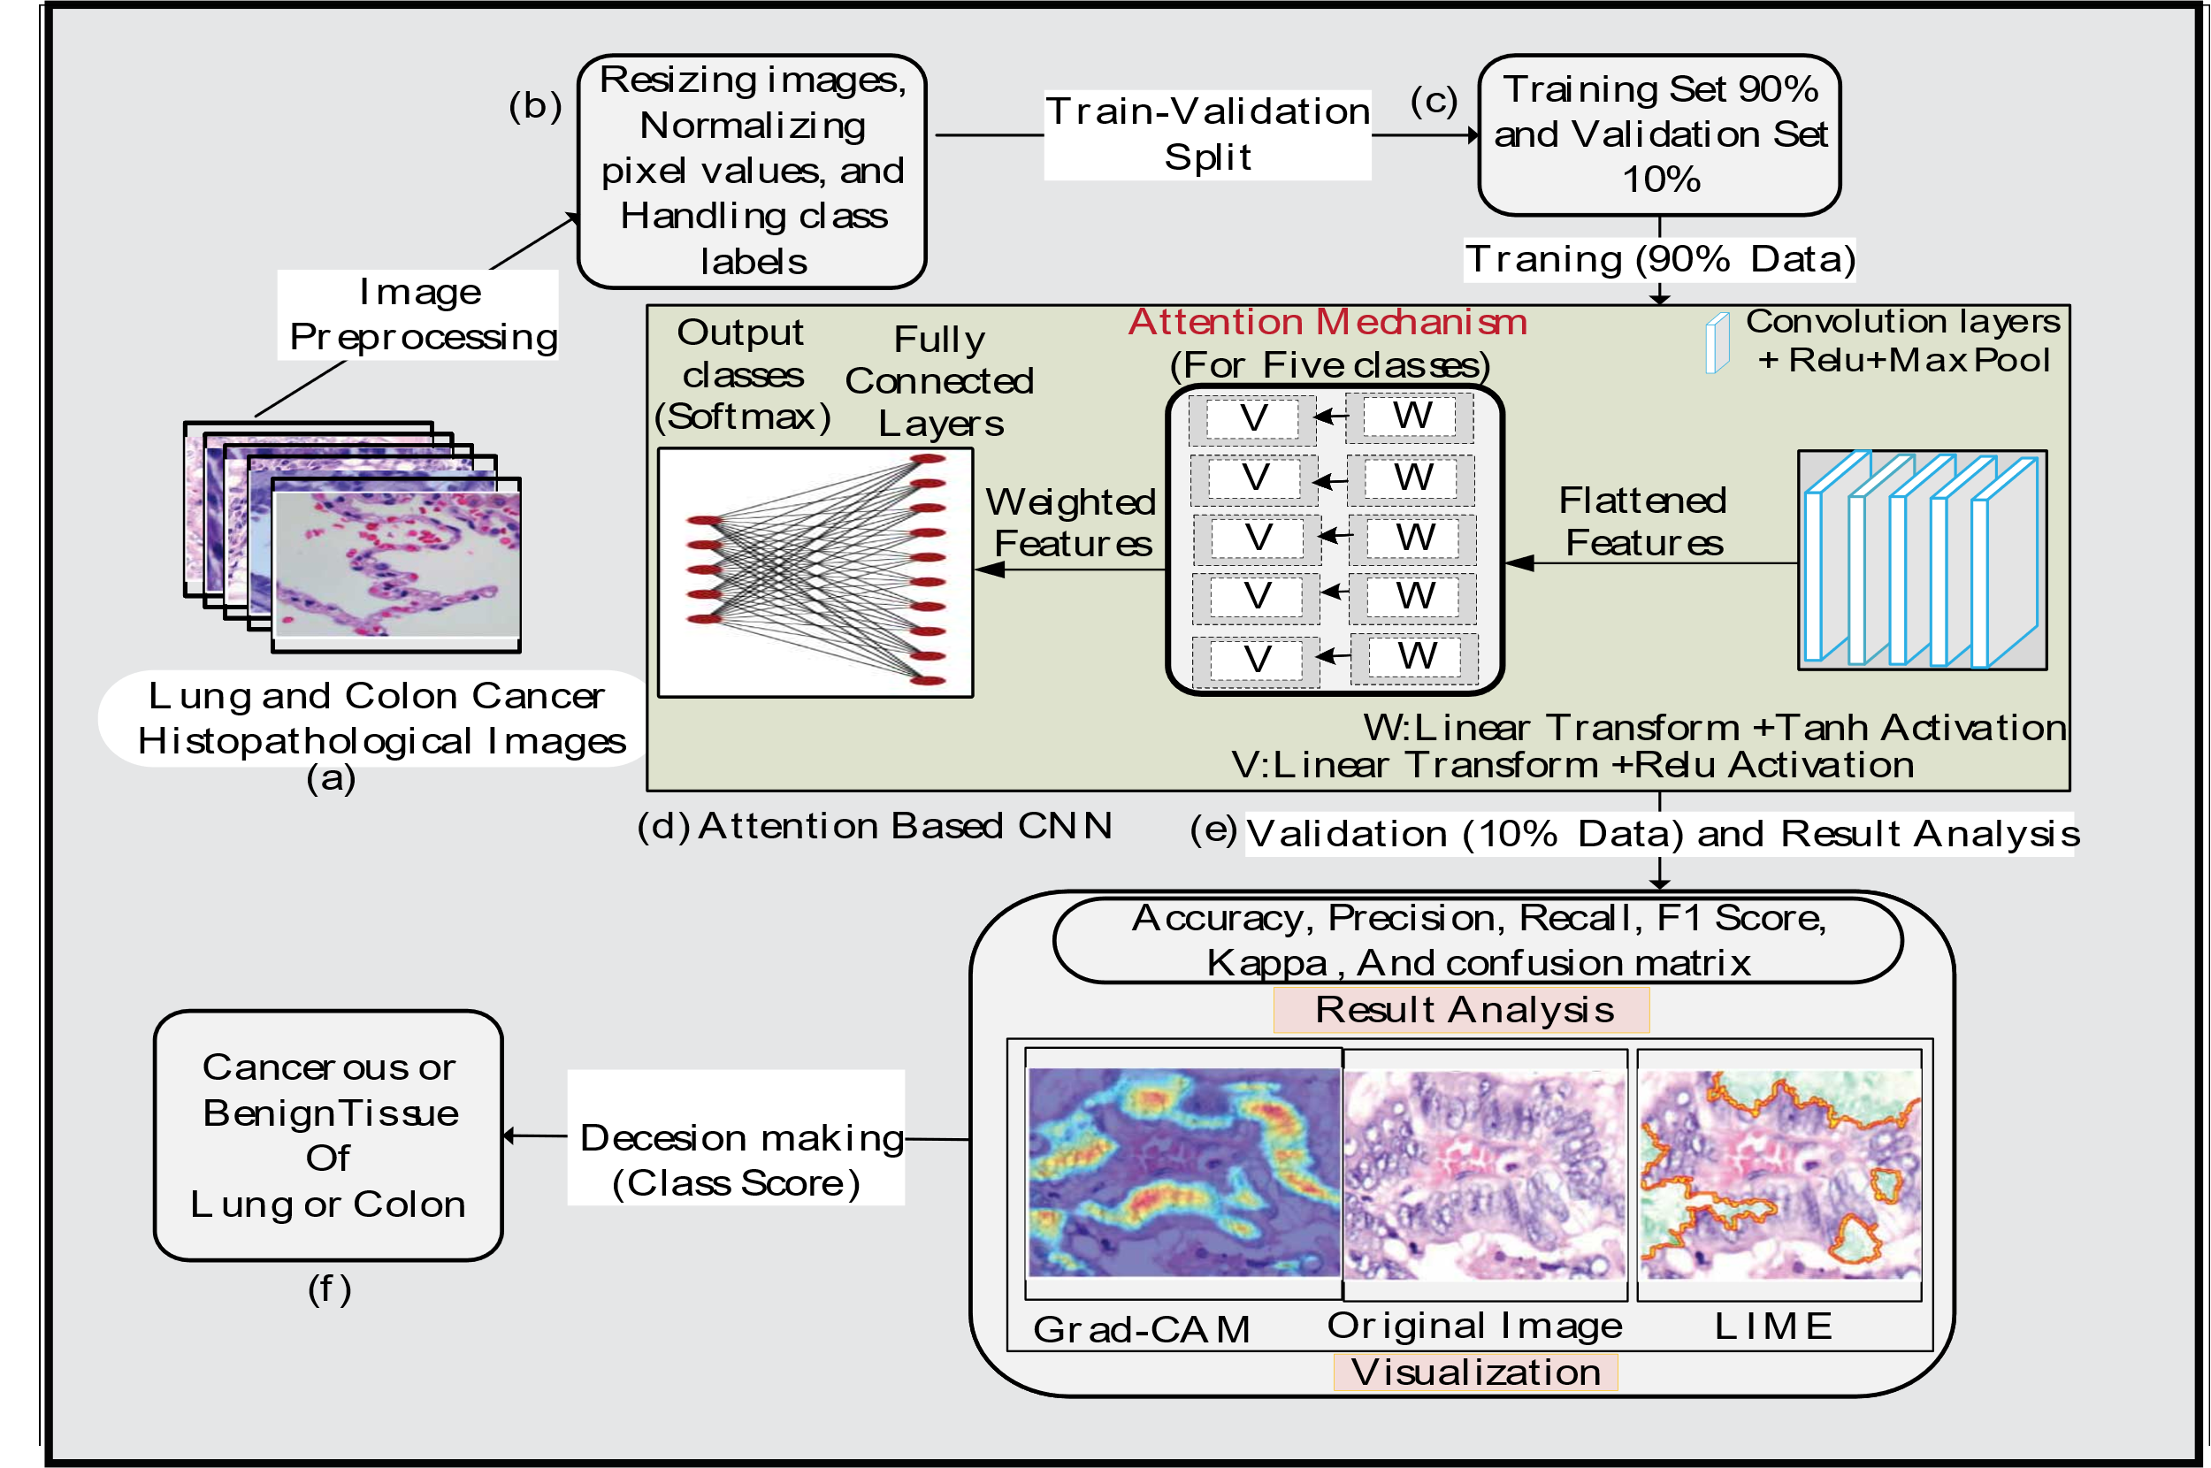
Methodology / System Architecture
Figure 1:Workflow of Class Specific Attention Based CNN (CSAB-CNN) model

Slide 11
Methodology / System Architecture(Cont.)
Key Function of CSAM-CNN
Feature Vectorization: Extracted features are transformed into a single vector, enabling efficient analysis by the Class-Specific Attention (CSA) module.
Class-Specific Weight Generation: The flattened feature vector is processed by attention mechanisms specific to each class, applying linear and Tanh transformations. This generates weights that highlight class-relevant features, with Softmax ensuring focus on the most significant ones.
Weighted Feature Combination: The CSA module combines these weighted vectors into a single optimized vector, enhancing the model's ability to differentiate subtle class differences. This feature vector is then passed
through a fully connected layer and a Softmax layer for final prediction.

Slide 12
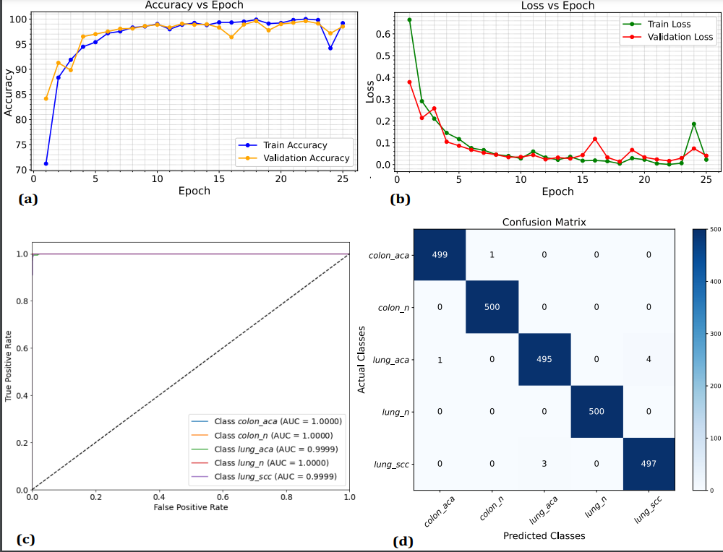
Experimental / Simulation Results
Figure 2: (a) Accuracy Curve against Epoch, (b) Loss Curve against Epoch, (c) ROC
Curve, and (d) Confusion Matrix shows robustness of the proposed model .

Slide 13
Experimental / Simulation Results(Cont.)
Class
Precision
Recall
F1-score
Accuracy
CSAB-CNN
S-CNN
CSAB-CNN
S-CNN
CSAB-CNN
S-CNN
CSAB-CNN
S-CNN
co
l
on
aca
0.9980
0.9979
0.9980
0.9960
0.9980
0.9970
0.9980
0.9988
co
l
on
n
0.9980
0.9980
1.0000
0.9980
0.9990
0.9980
1.0000
0.9992
l
ung
aca
0.9940
0.9878
0.9900
0.9780
0.9920
0.9829
0.9900
0.9932
l
ung
n
1.0000
0.9980
1.0000
1.00
1.0000
0.9990
1.0000
0.9996
l
ung
scc
0.9920
0.9782
0.9940
0.988
0.9930
0.9830
0.9940
0.9932
Table 1: Compares the performance of the CSAB-CNN and Standard CNN (S-CNN) across various classes, highlighting CSAB-CNN's slight improvements in1metrics, particularly in Recall and F1-score, with notable gains in Precision and Accuracy for the lung_scc class.
CSAB-CNN-Enhanced the performance

Slide 14

Experimental / Simulation Results (Cont.)
Table 2: Compares the performance of the CSAB-CNN and Standard CNN (S-CNN) across
various classes, highlighting CSAB-CNN's slight improvements in1metrics, particularly
in Recall and F1-score, with notable gains in Precision and Accuracy for the lung_scc class.
Ref.
[10]
1]
State of the Art Performance
Performance Validated By Visual Techniques( Lime and Grad-Cam)
[11]
[12]
[13]
[14]
[15]
[16]

Slide 15
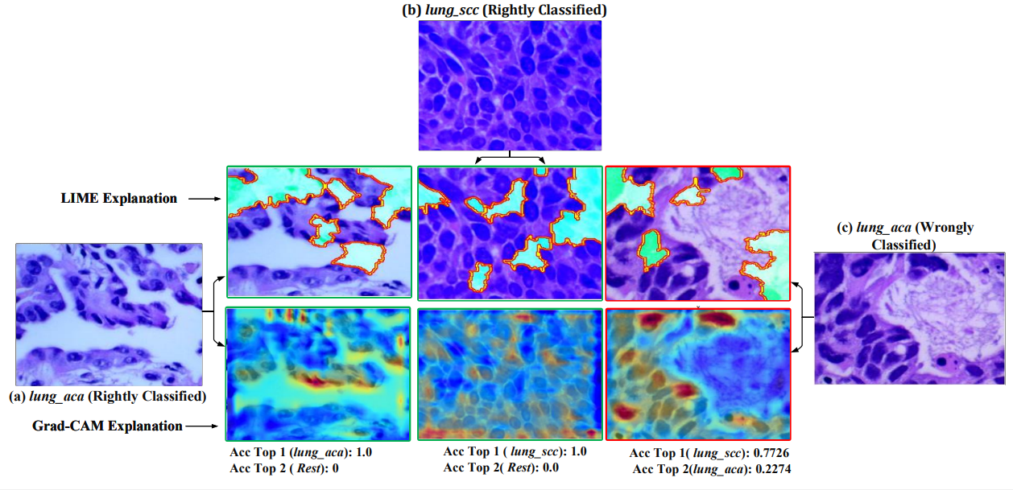
Experimental / Simulation Results (Cont.)
Figure 3: The figure compares model performance in diagnosing lung cancer using LIME and Grad-CAM techniques. It includes histopathological images labeled as "(a) lung_aca Rightly Classified" and "(c) lung_aca Wrongly Classified," showing correct and incorrect classifications. Each image is divided into upper panels with LIME explanations highlighting influential regions and lower panels with Grad-CAM heatmaps indicating influential areas. Text annotations like "Acc Top 1 (lung_aca)" and "Acc Top 2 (lung_scc)" denote activation levels for predicted classes, revealing the model’s confidence.

Slide 16
Conclusion:
Our model, a class-specific attention-based CNN, achieved 99.64% accuracy and precision
in classifying benign and cancerous tissues.
High Kappa score (99.50%) indicates strong agreement and reliability.
LIME and Grad-CAM visualizations further validate model accuracy.
Demonstrates the potential of attention-based CNNs for effective tissue classification.

Slide 17
Future Research Direction
Explore advanced attention mechanisms to enhance model robustness.
Implement comprehensive validation methods to ensure model reliability.
Foster collaborations to develop extensive, curated datasets for broader applicability.

Slide 18
References
[1] | F. Bray, M. Laversanne, E. Weiderpass, and I. Soerjomataram, "The ever-increasing importance of cancer as a leading cause of premature death worldwide," Cancer, vol. 127, no. 16, pp. 3029–3030, 2021. [Online]. Available: Wiley Online Library.
[2] | Journal of Thoracic Oncology - Export Citations.
[3] | Hasan, M.A., Haque, F., Sabuj, S.R., Sarker, H., Goni, M.O.F., Rahman, F.,Rashid, M.M. (2024). An end-to-end lightweight multi-scale CNN for the classi-fication of lung and colon cancer with XAI integration. Technologies, 12(4), 56.
[4] | Provath MA, Deb K, Dhar PK, Shimamura T (2023). Classification of lung andcolon cancer histopathological images using global context attention based convo-lutional neural network. IEEE Access.
[5] | R. AlGhamdi, T. O. Asar, F. Y. Assiri, R. A. Mansouri, and M. Ragab, "Al-BiruniEarth Radius Optimization with Transfer Learning Based Histopathological ImageAnalysis for Lung and Colon Cancer Detection," Cancers, vol. 15, no. 13, pp. 3300,2023. MDPI.
[6] | S. Mangal, A. Chaurasia, and A. Khajanchi, "Convolution neural networksfor diagnosing colon and lung cancer histopathological images," arXiv preprintarXiv:2009.03878, 2020.

Slide 19
References
[7] | F. Bray, M. Laversanne, E. Weiderpass, and I. Soerjomataram, "The ever-increasing importance of cancer as a leading cause of premature death worldwide," Cancer, vol. 127, no. 16, pp. 3029–3030, 2021. [Online]. Available: Wiley Online Library.
[8] | Journal of Thoracic Oncology - Export Citations.
[9] | Hasan, M.A., Haque, F., Sabuj, S.R., Sarker, H., Goni, M.O.F., Rahman, F.,Rashid, M.M. (2024). An end-to-end lightweight multi-scale CNN for the classi-fication of lung and colon cancer with XAI integration. Technologies, 12(4), 56.
[10] | R. AlGhamdi, T. O. Asar, F. Y. Assiri, R. A. Mansouri, and M. Ragab, "Al-BiruniEarth Radius Optimization with Transfer Learning Based Histopathological ImageAnalysis for Lung and Colon Cancer Detection," Cancers, vol. 15, no. 13, pp. 3300,2023. MDPI.
[11] | S. Anjum, I. Ahmed, M. Asif, H. Aljuaid, F. Alturise, Y. Y. Ghadi, and R. Elhabob,"Lung Cancer Classification in Histopathology Images Using Multiresolution Effi-cient Nets," Computational Intelligence and Neuroscience, vol. 2023, pp. 7282944,2023. doi: 10.1155/2023/7282944.
[12] | M. Masud, N. Sikder, A.-A. Nahid, A. K. Bairagi, and M. A. AlZain, "A machinelearning approach to diagnosing lung and colon cancer using a deep learning-basedclassification framework," Sensors, vol. 21, no. 3, pp. 748, 2021. MDPI.

Slide 20
References
[13] | A. F. M. K. Uddin, M. A. Sumon, S. Pervin, and F. Sharmin, "Lung Cancer Clas-sification using Modified U-Net based Lobe Segmentation and Nodule Detection,"Thieme Medical and Scientific Publishers Pvt. Ltd., 2023.
[14] | Hasan, M.A., Haque, F., Sabuj, S.R., Sarker, H., Goni, M.O.F., Rahman, F.,Rashid, M.M. (2024). An end-to-end lightweight multi-scale CNN for the classi-fication of lung and colon cancer with XAI integration. Technologies, 12(4), 56.
[15] | S. Anjum, I. Ahmed, M. Asif, H. Aljuaid, F. Alturise, Y. Y. Ghadi, and R. Elhabob,"Lung Cancer Classification in Histopathology Images Using Multiresolution Effi-cient Nets," Computational Intelligence and Neuroscience, vol. 2023, pp. 7282944,2023. doi: 10.1155/2023/7282944.
[16] | O. Singh, K. L. Kashyap, and K. K. Singh, "Lung and Colon Cancer Classifica-tion of Histopathology Images Using Convolutional Neural Network," SN ComputerScience, vol. 5, no. 2, pp. 223, 2024. Springer.

Slide 21
Acknowledgement
Funded by the ICT Division under the Ministry of Post, Telecommunication, and
Information Technology, Government of Bangladesh, through the ICT Fellowship Program.
Grateful to the Government of Bangladesh and Khulna University’s CSE Discipline for
their essential support.

Slide 22
Thank You.

